Slide 1
CSE 308 Software Engineering and Information System Design Sessional
Automation of
BCB’s
Game Development Committee
Group No: 01
Group Members:1005091
1005111
1005113
1005115
1005120
Collaboration diagram & Class diagram

Slide 2
Subsystems
School Cricket Management System
Youth Cricket Management System
Facilities and Equipment Management System
Divisional Cricket Management System
Academy Operations Management System
Coach Management System
Control Management System

Slide 3
School Cricket management
System

Slide 4
School registration: Noun Identification
Actor Action (School Representative, School cricket administrator ) | System Response
1.none | 2. Show registration Form
3. Submit registration form. | 4. Send registration form to School cricket administrator
5. School Cricket Administrator accepts or rejects the Registration request. | 6. If accepts, then the system enrolls the school and save the school info into database. If rejects, then the system ignores the school info.
 | 7. Send acceptance/ decline message to School representative.

Slide 5
School registration: Entity
School
RegistrationInfo

Slide 6
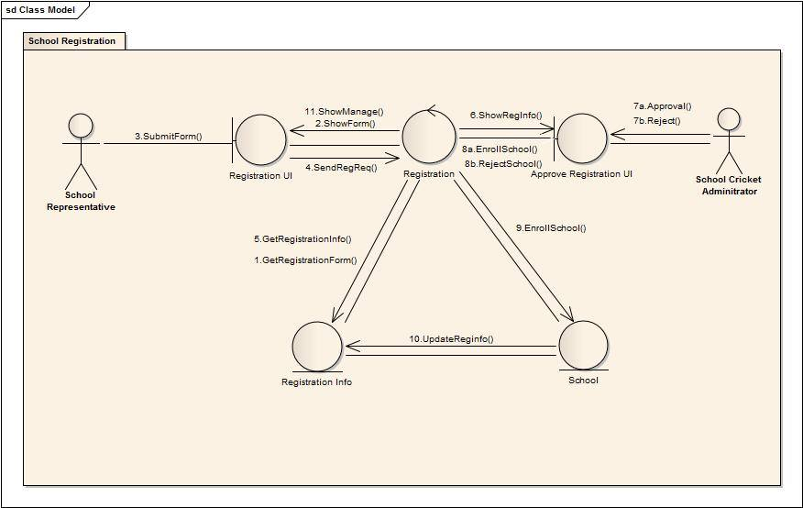
School registration: Collaboration Diagram

Slide 7
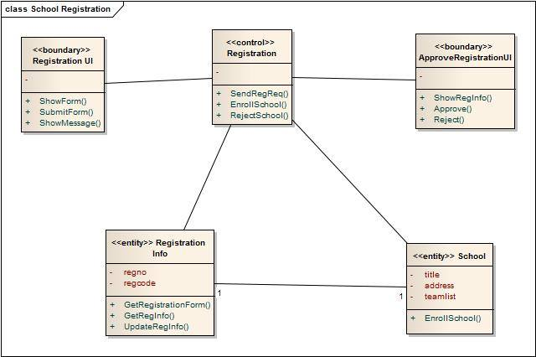
School registration: Class Diagram

Slide 8
Arrange School Cricket Tournament :
Noun Identification
Actor Action (School cricket administrator, Program manager ) | System Response
1.none | 2. Get school information
3. none | 4. Get ground database and show them to school cricket administrator
5. School Cricket Administrator schedules tournament | 6. Sends approval request to program manager
7. Program manager approves or rejects the tournament | 8. If accepts then updates school tournament info, school info and ground info.

Slide 9
Arrange School Cricket Tournament : Entity
School
SchoolTournament
Ground

Slide 10
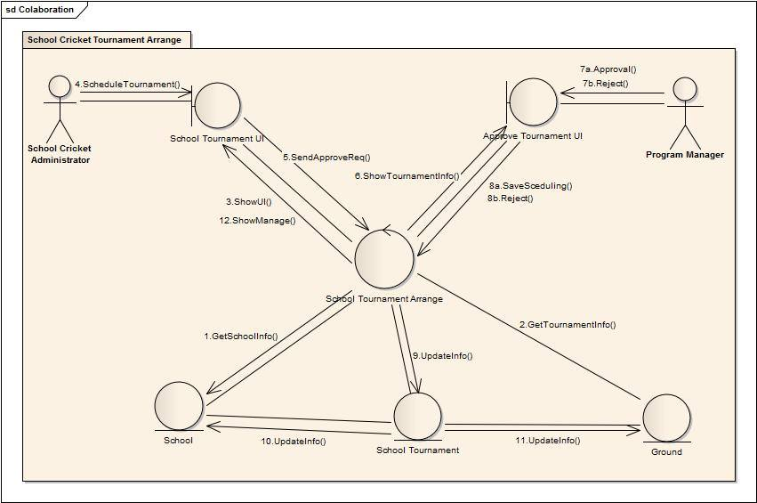
Arrange School Cricket Tournament :
Collaboration Diagram

Slide 11
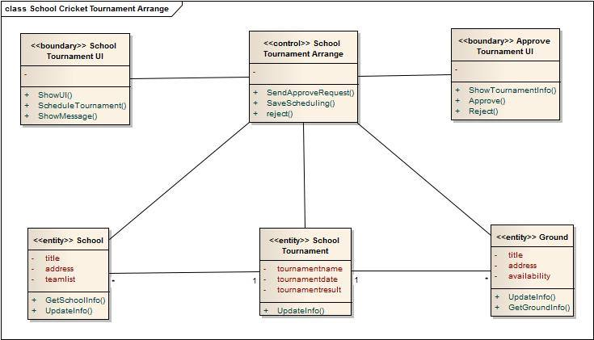
School Cricket Tournament Arrange: Class Diagram

Slide 12
Youth Cricket management
System

Slide 13
Arrange Youth Cricket Tournament :
Noun Identification
Actor Action (School Representative, School cricket administrator ) | System Response
1.none | 2. Get team information
 | 3. Get ground database and show them to youth cricket administrator
5. Youth Cricket Administrator schedules tournament | 6. Sends approval request to program manager
7. Program manager approves or rejects the tournament | 8. If accepts then updates youth tournament info, youthTeam info and ground info.

Slide 14
Arrange Youth Cricket Tournament : Entity
YouthTeams
YouthTournaments
Ground

Slide 15
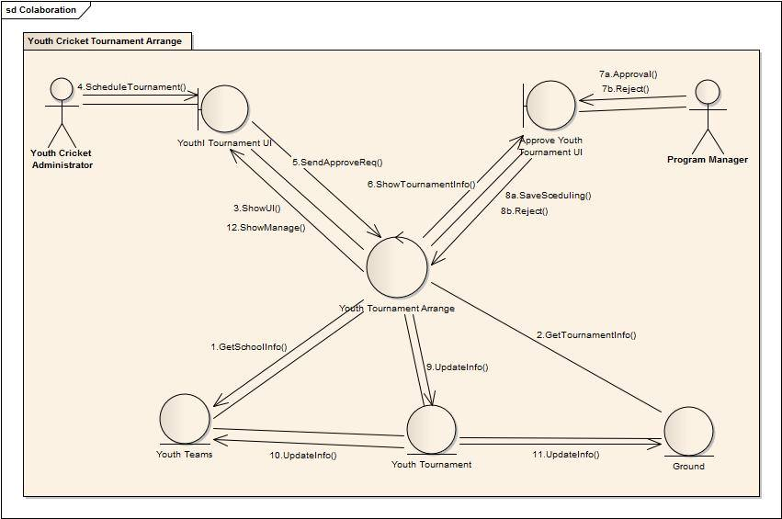
Arrange Youth Cricket Tournament :
Collaboration Diagram

Slide 16
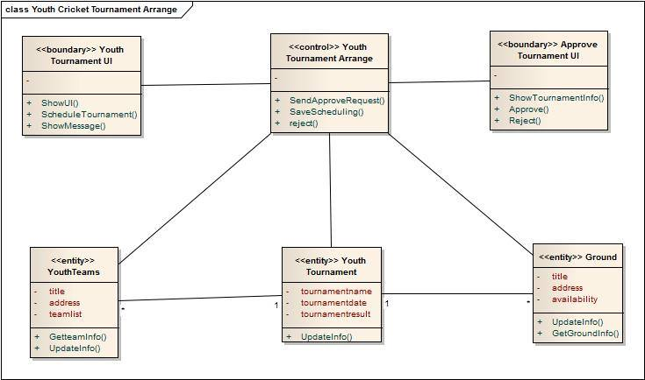
Youth Cricket Tournament Arrange:
Class Diagram

Slide 17
Update Tournament Info:
Noun Identification
Actor Action (Youth cricket administrator ) | System Response
1.none | 2. Get tournaments and show them to youth admin.
3. Youth Cricket Administrator selects tournament | 4. Get tournament information and show them to youth cricket administrator
5. Youth Cricket Administrator updates tournament information | 6. Updates youthTournament and youthTeams database.
1.none | 2. Get tournaments and show them to youth admin.

Slide 18
Update Tournament Info :
Entity
YouthTeams
YouthTournament
Tournaments

Slide 19
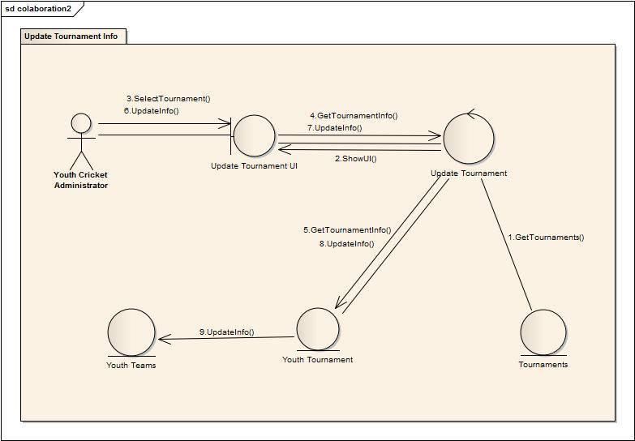
Update Tournament Info:
Collaboration Diagram

Slide 20
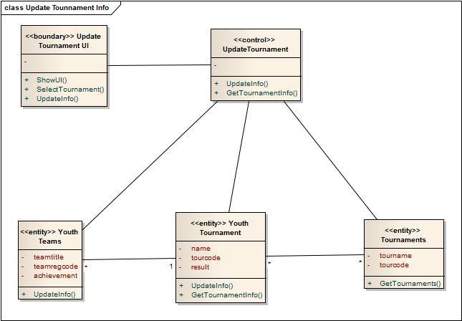
Update Tournament Info: Class Diagram

Slide 21
Facilities & Equipment management
System

Slide 22
Ask for facilities:
Noun Identification
Actor Action (Youth cricket administrator, School Cricket Administrator ) | System Response
1.none | 2. System will show a window to the school cricket administrator or youth cricket administrator.
3. school cricket administrator, Youth Cricket Administrator send list of facilities to the facility administrator | 4. System will save the list of requests and notify the facility administrator
5. Facility Administrator show the facility requests
1.none | 2. System will show a window to the school cricket administrator and youth cricket administrator.

Slide 23
Ask for facilities :
Entity
FacilityLists

Slide 24
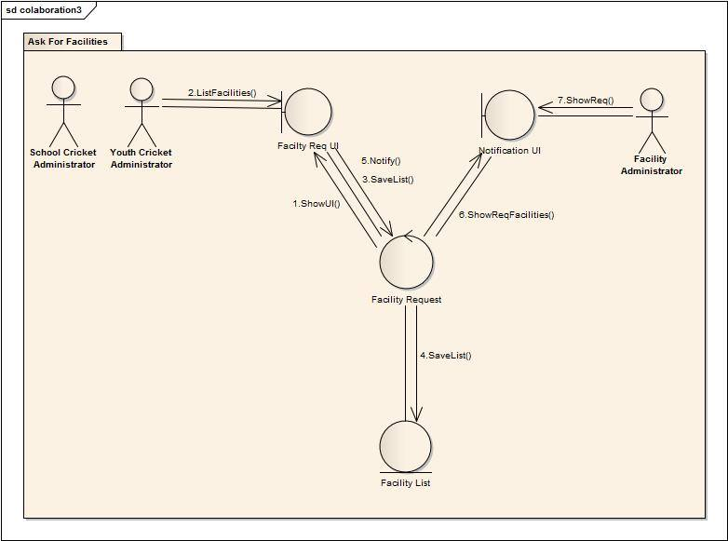
Ask for facilities:
Collaboration Diagram

Slide 25
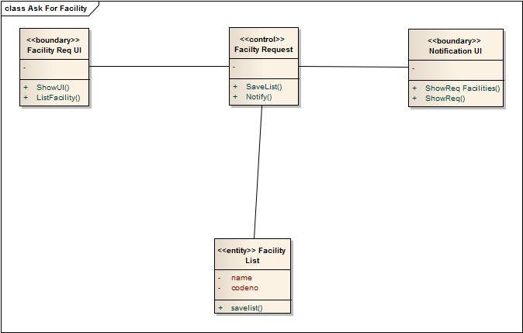
Ask for Facilities: Class Diagram

Slide 26
Provide Facilites:
Noun Identification
Actor Action (Facility Admin, Program Manager ) | System Response
1.none | 2. Get facilityList and show list to facility admin
3. Facility admin selects facility | 4. Stores provided facilities to provided facilities and updates facilities and facilityList
5. Facility admin reports about facilities | 6. shows report to program manager
1.none | 2. Get facilityList and show list to facility admin

Slide 27
Provide Facilites :
Entity
FacilityLists
ProvidedFacilities

Slide 28
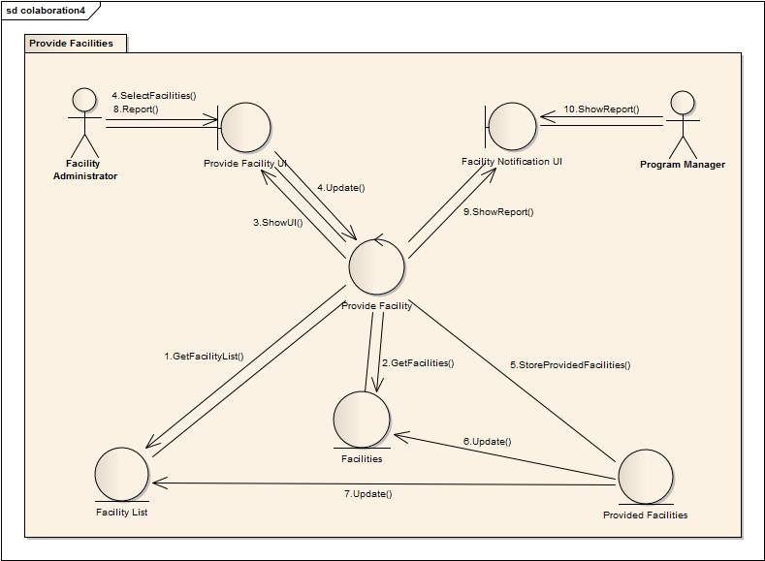
Provide facilities:
Collaboration Diagram

Slide 29
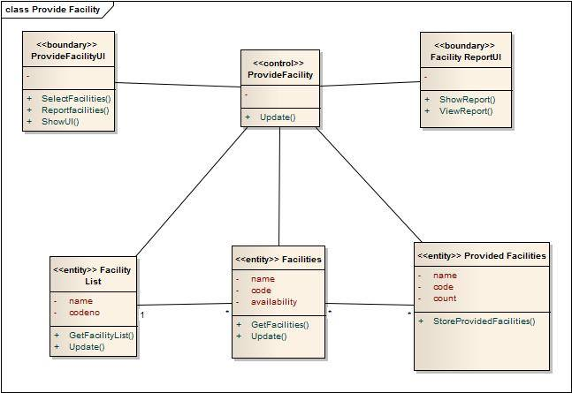
Provide facilities:
Class Diagram

Slide 30
Divisional
Cricket management
System

Slide 31
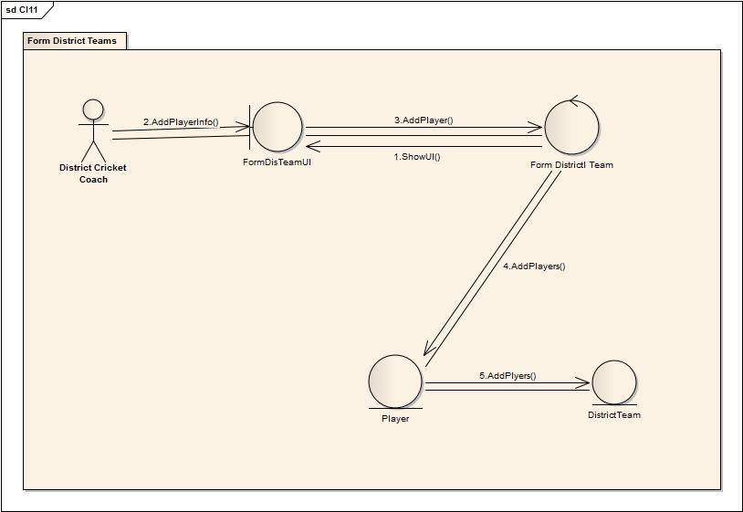
Form District Team :
Collaboration Diagram

Slide 32
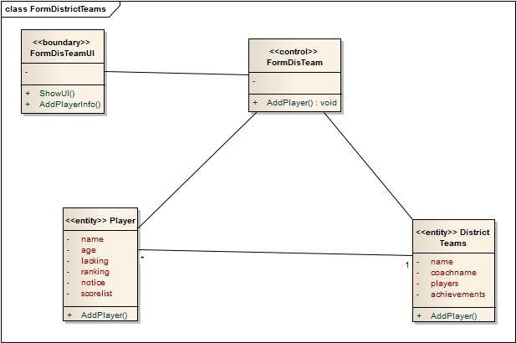
Form District Team :
Class Diagram

Slide 33
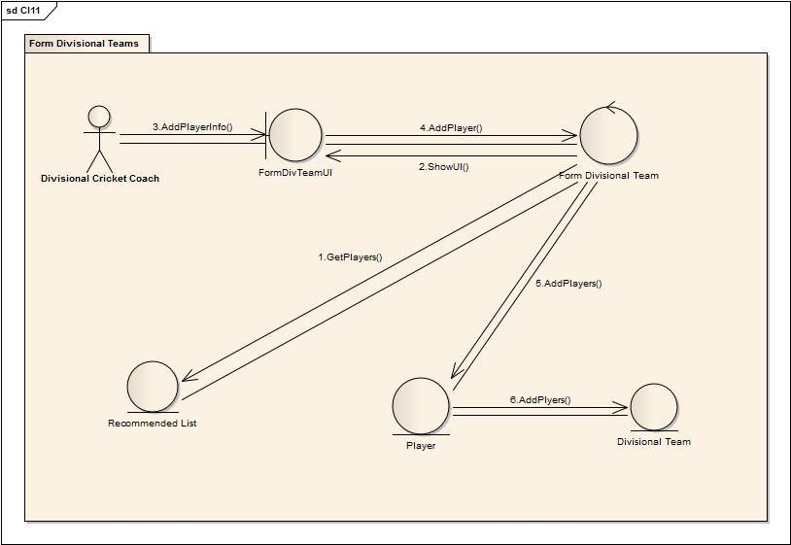
Form Divisional Team:
Collaboration Diagram

Slide 34
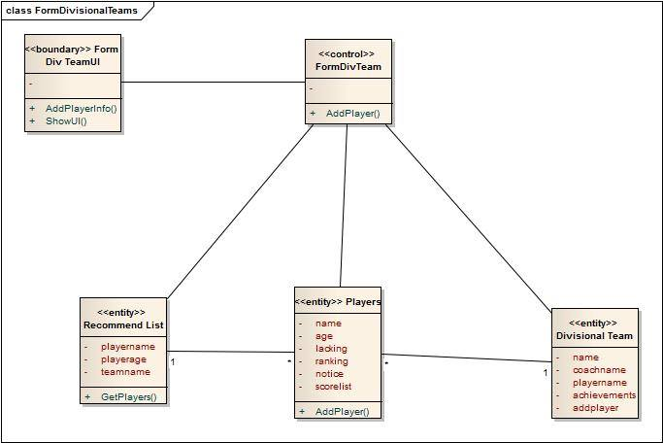
Form Divisional Team:
Class Diagram

Slide 35
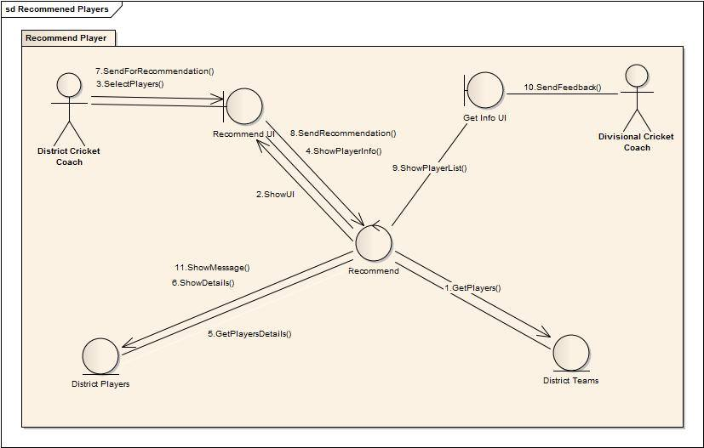
Recommend Players:
Collaboration Diagram

Slide 36
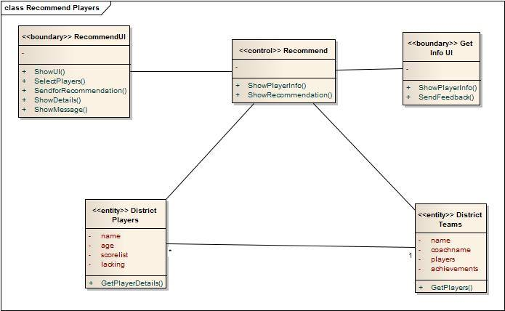
Recommend Players:
Class Diagram

Slide 37
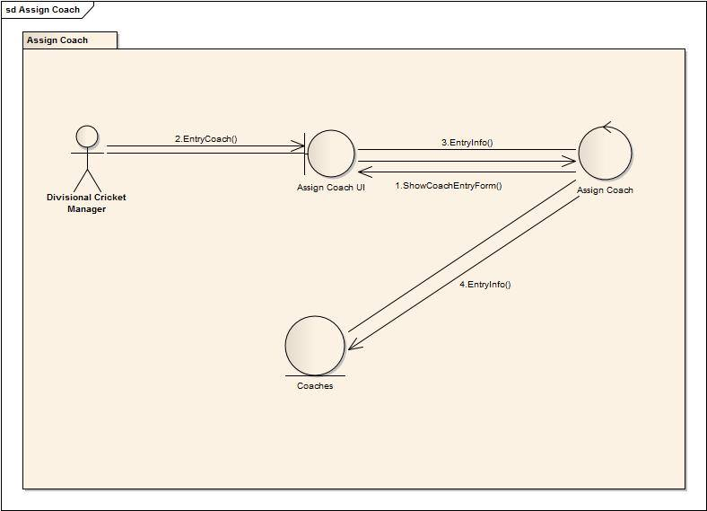
Assign Coach:
Collaboration Diagram

Slide 38
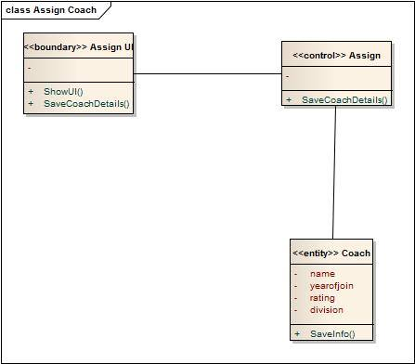
Assign Coach: Class Diagram

Slide 39
Academy Operations
management
System

Slide 40
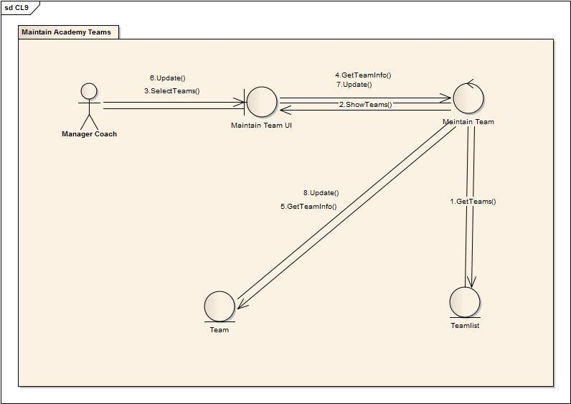
Maintain Academy Teams:
Collaboration Diagram

Slide 41
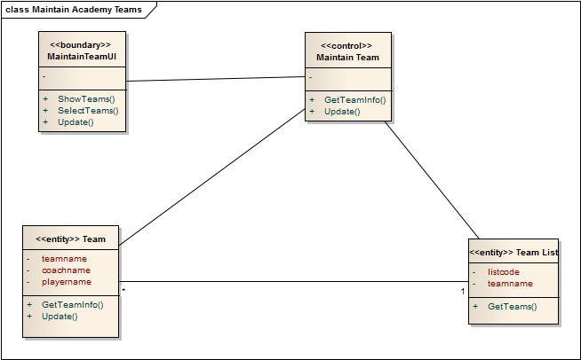
Maintain Academy Teams:
Class Diagram

Slide 42
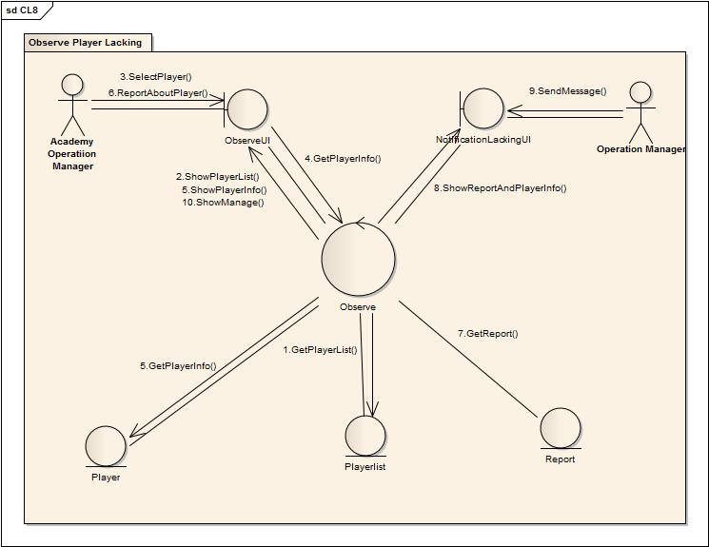
Observe player lacking:
Collaboration Diagram

Slide 43
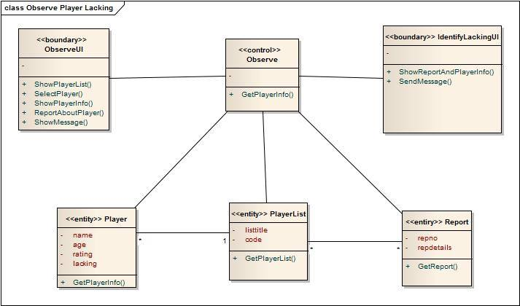
Observe Player Lacking: Class Diagram

Slide 44
Coach management
System

Slide 45
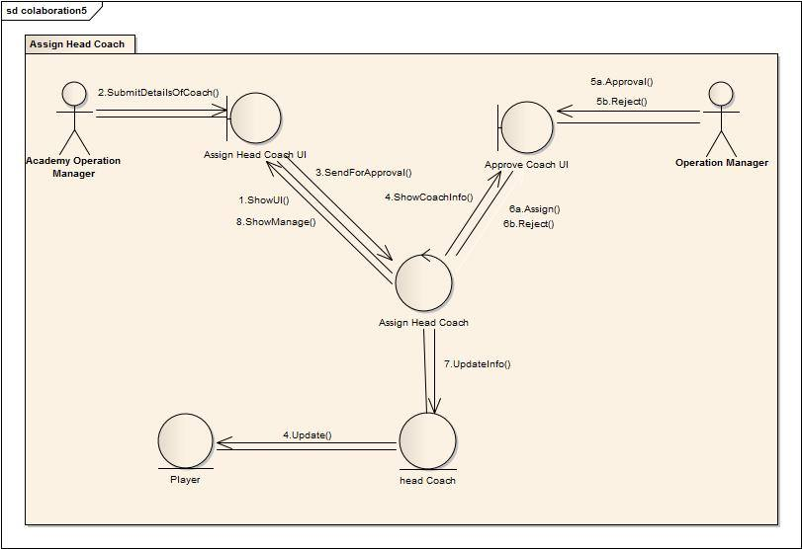
Assign Head Coach:
Collaboration Diagram

Slide 46
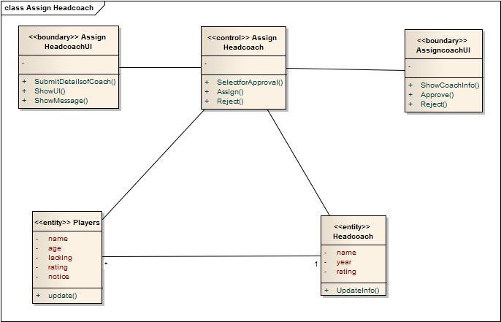
Assign Head Coach: Class Diagram

Slide 47
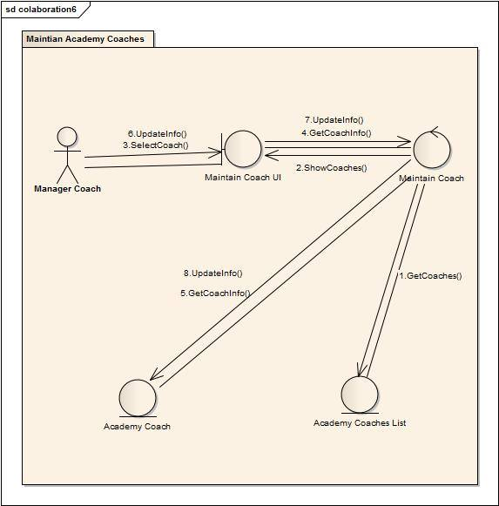
Maintain Academy Coaches:
Collaboration Diagram

Slide 48
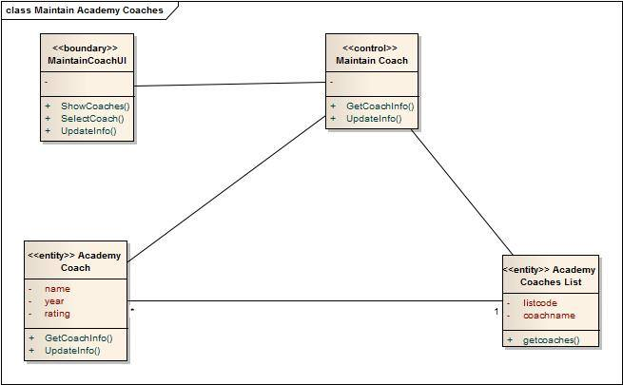
Maintain Academy Coaches: Class Diagram

Slide 49
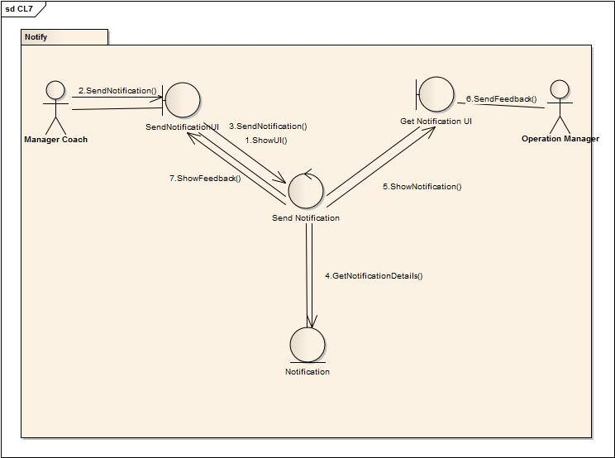
Notify:
Collaboration Diagram

Slide 50
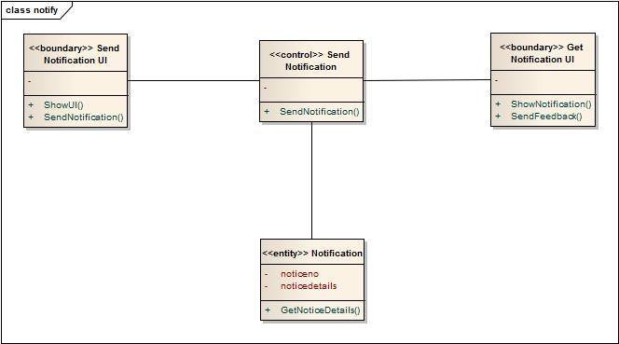
Notify: Class Diagram

Slide 51
Control
management
System

Slide 52
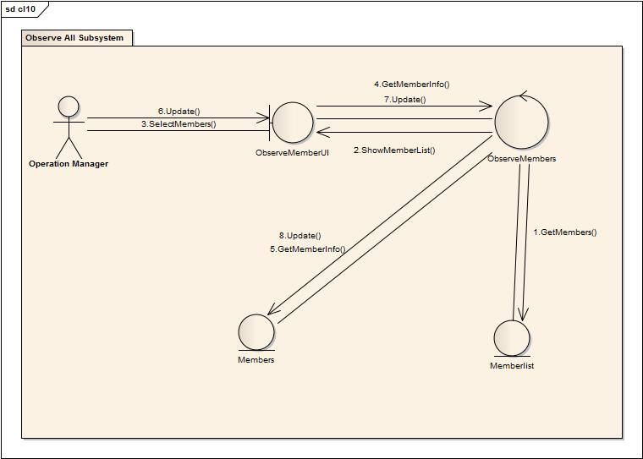
Observe all subsystems:
Collaboration Diagram

Slide 53
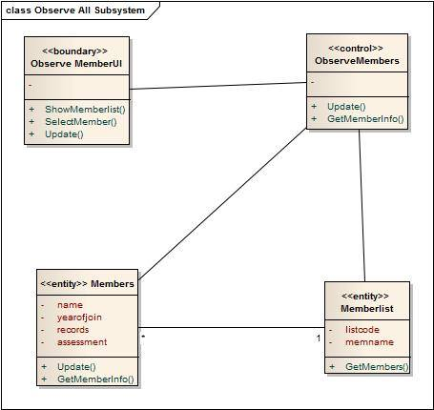
Observe All Subsystem: Class Diagram

Slide 54
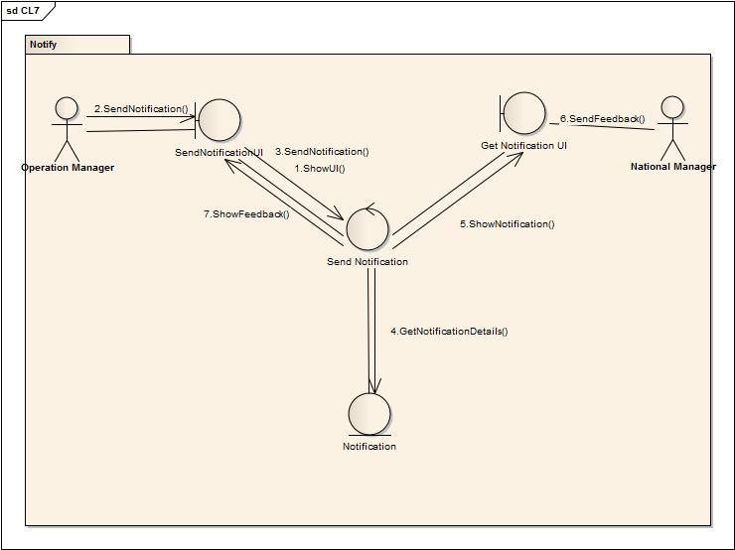
Notify:
Collaboration Diagram

Slide 55
Notify: Class Diagram

Slide 56
Thank You

